Slide 1
Final Project Walkthrough

Slide 2
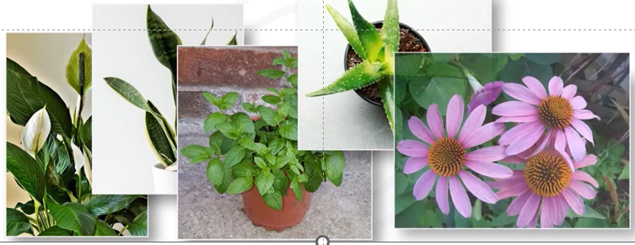
Paradise nursery shopping application

Slide 3




paradise nursery shopping application

Slide 4
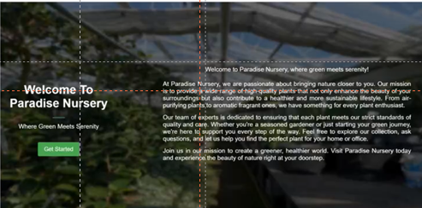
Landing page

Slide 5
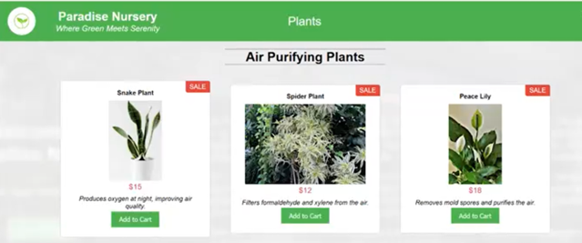
Product listing page

Slide 6
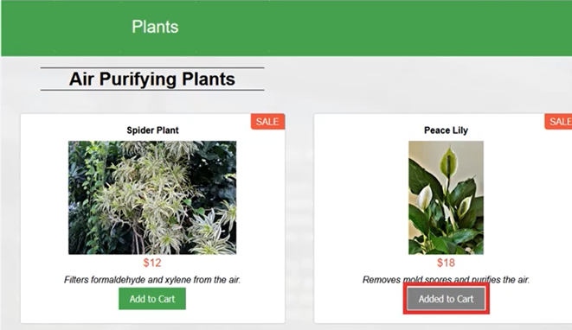
Plant details

Slide 7
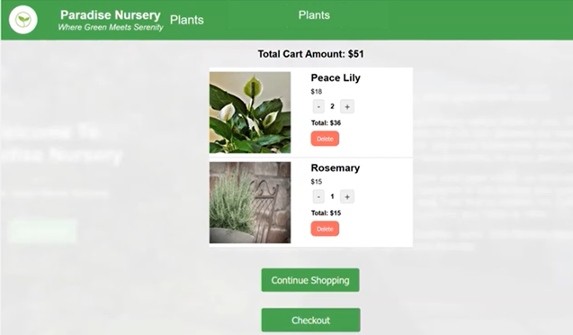
Other shopping cart elements

Slide 8
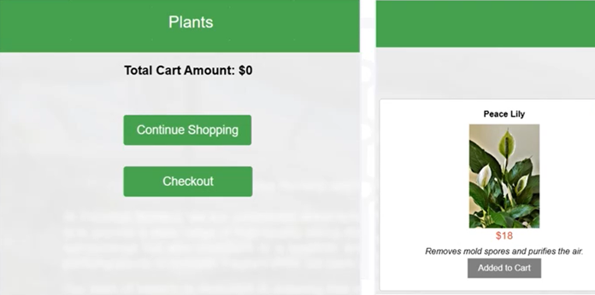
Other details

Slide 9

Good luck!

